Slide 1
13
C Preprocessor

Slide 2
Hold thou the good; define it well.
  Alfred, Lord Tennyson
I have found you an argument; but I am not obliged to find you an understanding.
  Samuel Johnson
A good symbol is the best argument, and is a
missionary to persuade thousands.
  Ralph Waldo Emerson

Slide 3
Conditions are fundamentally sound.
  Herbert Hoover [December 1929]
The partisan, when he is engaged in a dispute,
cares nothing about the rights of the question,
but is anxious only to convince his hearers of
his own assertions.
  Plato

Slide 4
OBJECTIVES
In this chapter you will learn:
To use #include for developing large programs.
To use #define to create macros and macros with arguments.
To use conditional compilation to specify portions of a program that should not always be compiled (such as code that assists you in debugging).
To display error messages during conditional compilation.
To use assertions to test if the values of expressions are correct.

Slide 5
13.1 Introduction
13.2 #include Preprocessor Directive
13.3 #define Preprocessor Directive: Symbolic Constants
13.4 #define Preprocessor Directive: Macros
13.5 Conditional Compilation
13.6 #error and #pragma Preprocessor Directives
13.7 # and ## Operators
13.8 Line Numbers
13.9 Predefined Symbolic Constants
13.10 Assertions

Slide 6
13.1 Introduction
Preprocessing
  Occurs before a program is compiled
  Inclusion of other files
  Definition of symbolic constants and macros
  Conditional compilation of program code
  Conditional execution of preprocessor directives
Format of preprocessor directives
  Lines begin with #
  Only whitespace characters before directives on a line

Slide 7
13.2 The #include Preprocessor Directive
#include
  Copy of a specified file included in place of the directive
  #include <filename>
    Searches standard library for file
    Use for standard library files
  #include "filename"
    Searches current directory, then standard library
    Use for user-defined files
  Used for:
    Programs with multiple source files to be compiled together
    Header file – has common declarations and definitions (classes, structures, function prototypes)
      #include statement in each file

Slide 8
13.3 The #define Preprocessor Directive: Symbolic Constants
#define
  Preprocessor directive used to create symbolic constants and macros
  Symbolic constants
    When program compiled, all occurrences of symbolic constant replaced with replacement text
  Format
      #define identifier replacement-text
  Example:
      #define PI 3.14159
  Everything to right of identifier replaces text
      #define PI = 3.14159
    Replaces “PI” with "= 3.14159"
  Cannot redefine symbolic constants once they have been created

Slide 9
Good Programming Practice 13.1
Using meaningful names for symbolic constants helps make programs more
self-documenting.

Slide 10
Good Programming Practice 13.2
By convention, symbolic constants are defined using only uppercase letters and underscores.

Slide 11
13.4 The #define Preprocessor Directive: Macros
Macro
  Operation defined in #define
  A macro without arguments is treated like a symbolic constant
  A macro with arguments has its arguments substituted for replacement text, when the macro is expanded
  Performs a text substitution – no data type checking
  The macro
    #define CIRCLE_AREA( x ) ( PI * ( x ) * ( x ) )
  would cause
    area = CIRCLE_AREA( 4 );
  to become
    area = ( 3.14159 * ( 4 ) * ( 4 ) );

Slide 12
13.4 The #define Preprocessor Directive: Macros
Use parentheses
  Without them the macro
    #define CIRCLE_AREA( x ) PI * ( x ) * ( x )
  would cause
    area = CIRCLE_AREA( c + 2 );
  to become
    area = 3.14159 * c + 2 * c + 2;
Multiple arguments
    #define RECTANGLE_AREA( x, y ) ( ( x ) * ( y ) )
  would cause
    rectArea = RECTANGLE_AREA( a + 4, b + 7 );
  to become
    rectArea = ( ( a + 4 ) * ( b + 7 ) );

Slide 13
Common Programming Error 13.1
Forgetting to enclose macro arguments in parentheses in the replacement text can lead to logic errors.

Slide 14
Performance Tip 13.1
Macros can sometimes be used to replace a function call with inline code prior to execution time. This eliminates the overhead of a function call. Today’s optimizing compilers will often inline functions for you, so many programmers no longer use macros for this purpose.

Slide 15
13.4 The #define Preprocessor Directive: Macros
#undef
  Undefines a symbolic constant or macro
  If a symbolic constant or macro has been undefined it can later be redefined

Slide 16
13.5 Conditional Compilation
Conditional compilation
  Control preprocessor directives and compilation
  Cast expressions, sizeof, enumeration constants cannot be evaluated in preprocessor directives
  Structure similar to if
      #if !defined( NULL )
      #define NULL 0
      #endif
    Determines if symbolic constant NULL has been defined
      If NULL is defined, defined( NULL ) evaluates to 1
      If NULL is not defined, this function defines NULL to be 0
  Every #if must end with #endif
  #ifdef short for #if defined( name )
  #ifndef short for #if !defined( name )

Slide 17
13.5 Conditional Compilation
Other statements
  #elif – equivalent of else if in an if statement
  #else – equivalent of else in an if statement
"Comment out" code
  Cannot use /* ... */
  Use
      #if 0
        code commented out
      #endif
  To enable code, change 0 to 1

Slide 18
13.5 Conditional Compilation
Debugging
    #define DEBUG 1
    #ifdef DEBUG
    cerr << "Variable x = " << x << endl;
    #endif
  Defining DEBUG to 1 enables code
  After code corrected, remove #define statement
  Debugging statements are now ignored

Slide 19
Common Programming Error 13.2
Inserting conditionally compiled printf statements for debugging purposes in locations where C currently expects a single statement. In this case, the conditionally compiled statement should be enclosed in a compound statement. Thus, when the program is compiled with debugging statements, the flow of control of the program is not altered.

Slide 20
13.6 The #error and #pragma Preprocessor Directives
#error tokens
  Tokens are sequences of characters separated by spaces
    "I like C++" has 3 tokens
  Displays a message including the specified tokens as an error message
  Stops preprocessing and prevents program compilation
#pragma tokens
  Implementation defined action (consult compiler documentation)
  Pragmas not recognized by compiler are ignored

Slide 21
13.7 The # and ## Operators
#
  Causes a replacement text token to be converted to a string surrounded by quotes
  The statement
    #define HELLO( x ) printf( “Hello, ” #x “\n” );
  would cause
    HELLO( John )
  to become
    printf( “Hello, ” “John” “\n” );
  Strings separated by whitespace are concatenated when using printf

Slide 22
13.7 The # and ## Operators
##
  Concatenates two tokens
  The statement
    #define TOKENCONCAT( x, y ) x ## y
  would cause
    TOKENCONCAT( O, K )
  to become
    OK

Slide 23
13.8 Line Numbers
#line
  Renumbers subsequent code lines, starting with integer value
  File name can be included
  #line 100 "myFile.c"
    Lines are numbered from 100 beginning with next source code file
    Compiler messages will think that the error occurred in "myfile.C"
    Makes errors more meaningful
    Line numbers do not appear in source file

Slide 24
13.9 Predefined Symbolic Constants
Four predefined symbolic constants
  Cannot be used in #define or #undef

Slide 25
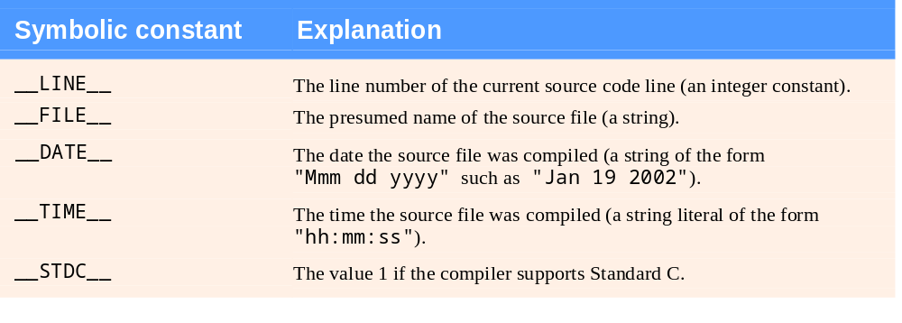
Fig. 13.1 | Some predefined symbolic constants.

Slide 26
13.10 Assertions
assert macro
  Header <assert.h>
  Tests value of an expression
  If 0 (false) prints error message and calls abort
  Example:
      assert( x <= 10 );
  If NDEBUG is defined
    All subsequent assert statements ignored
      #define NDEBUG

Slide 27
Software Engineering Observation 13.1
Assertions are not meant as a substitute for error handling during normal runtime conditions. Their use should be limited to finding logic errors.

